Slide 1
FAILURE REPORTING AND ANALYSIS SYSTEM (FRAS)

Slide 2
Features of the application
To facilitate the entire MRSAM fleet to process the Failure Report online and all its associated task.
Automatic generation of approved FRs in PDF format.
Dynamic generation of outstanding Failure Reports based on the selection of number of days.
Compare and analysis the failures of different MRSAM FUs in graphical presentation.
The comparison in graphical representation in respect of Cat-D items and Spares consumed by different FUs.

Slide 3
Features of the application
Facility to raise Cat-D and Spares records.
Instant check of Cat Ds with the vendors and its monitoring
To have online fault compendium which can be used as a reference for rectification and reduce the down time of the system
To show the Open Failure Reports as per the total number of days lapsed.
Enables the User to update IAI Docket No.
Enables the User to change his Password.

Slide 4
Functionality of different Users
Three level of users will accomplish the task of automation.
Admin User
Approval User
General User
Admin User – The role of this User is to manage the other two Users (Create, Update & Delete the User and Reset the password of User)

Slide 5
Functionality of different Users
General User – The following are the roles of the General User:
Raising the FR and forwarding it to Approval User for its Approval.
While raising the FR, User needs to mention the Spares used or any item became Cat-D.
Generates the PDF format of Approved FR.
Raising the Cat-D details, if shown against the FR
Furnishing the details of spares used for the specific FR
Closing the FR by updating the repair analysis details

Slide 6
Functionality of different Users
Receiving the Cat-D.
Updating the FRs with IAI Docket No.
Generates open FRs based on selected no. of days
Approval User – These users have the rights to Approve , Update and Delete FRs. In addition to this, they have the privileges of the General User.

Slide 7
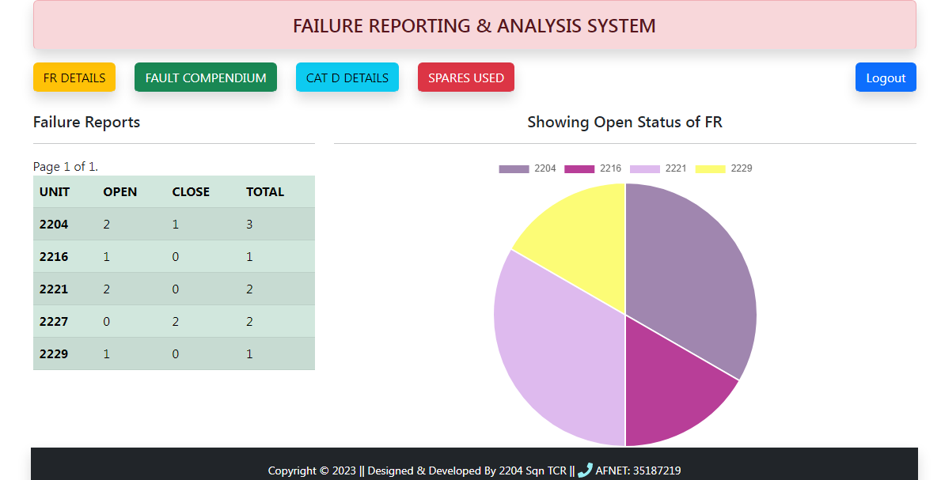
THE DASHBOARD
This feature will show “Open” and “Close” FRs for all MRSAM FUs
with graphical representation of only “Open” FRs

Slide 8
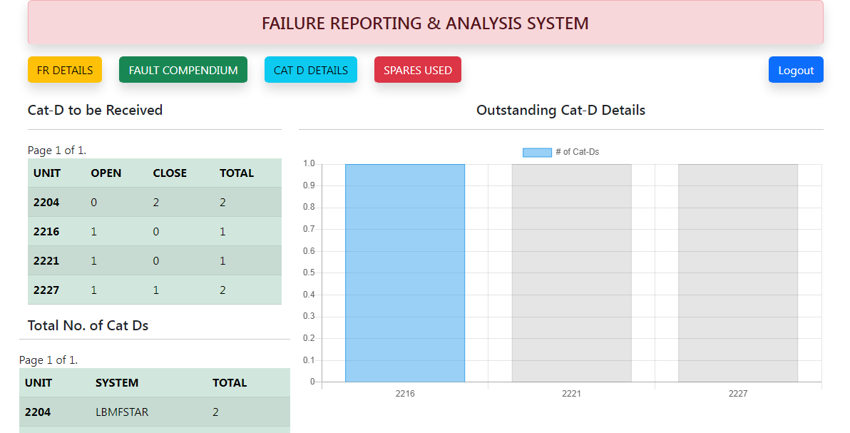
THE DASHBOARD
This feature will show “Open” and “Close” Cat Ds for all MRSAM FUs
with graphical representation of only “Open” Cat Ds

Slide 9
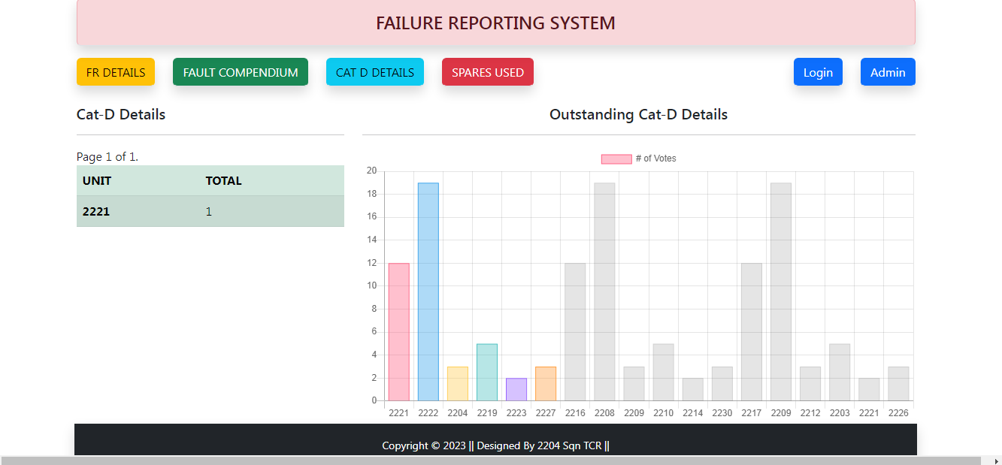
THE DASHBOARD

Slide 10
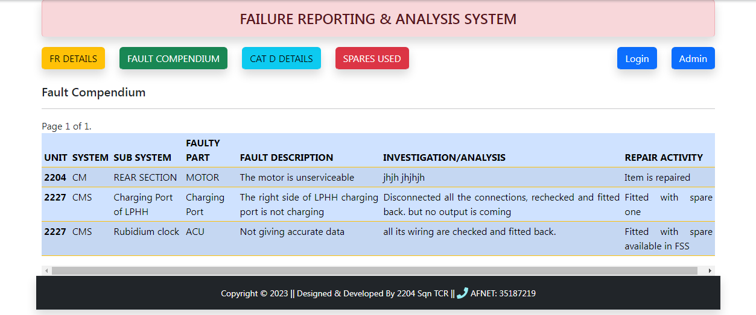
THE DASHBOARD
It’s a Fault Compendium which will show all the faults occurred and
rectified at all MRSAM FUs,

Slide 11
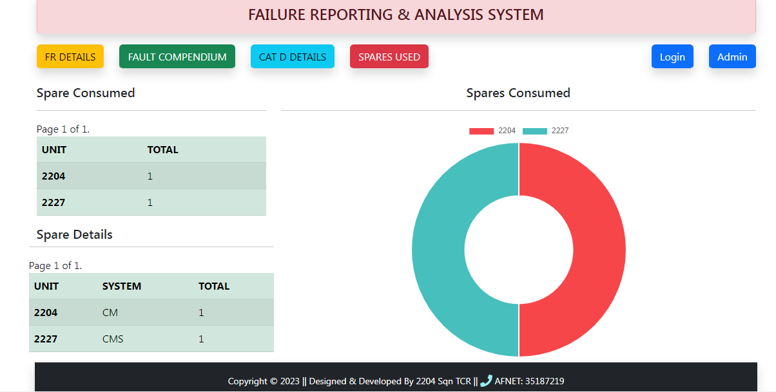
THE DASHBOARD
This feature will show the total number of spares consumed by
respective MRSAM FUs

Slide 12
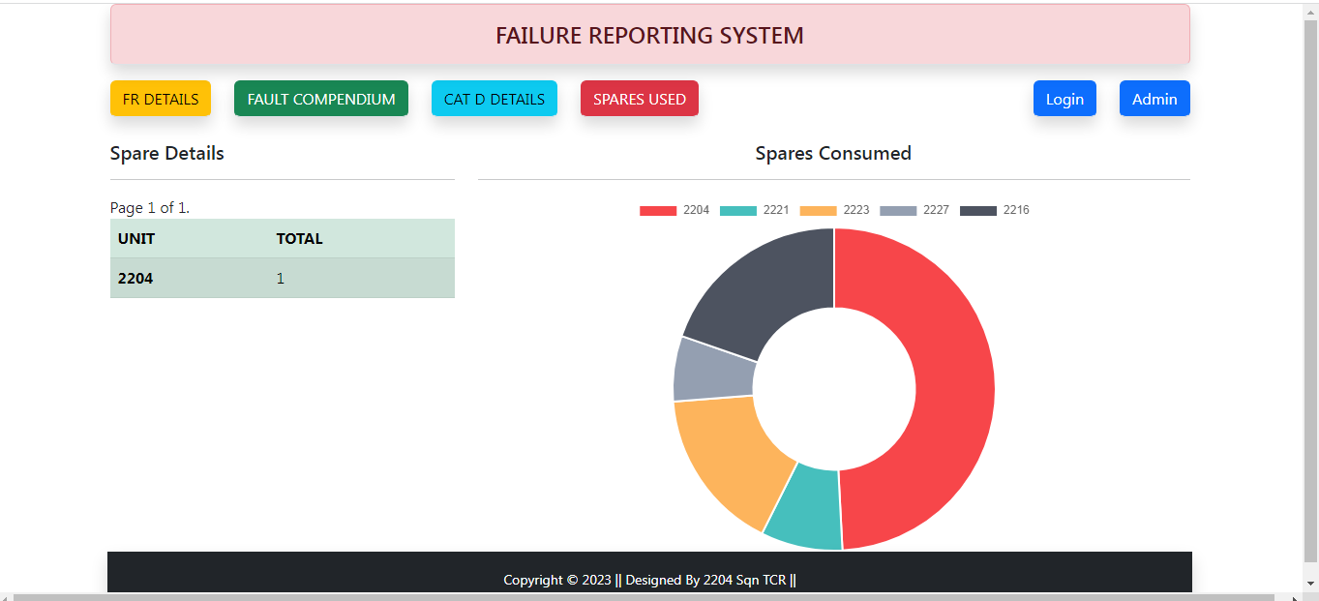
THE DASHBOARD

Slide 13
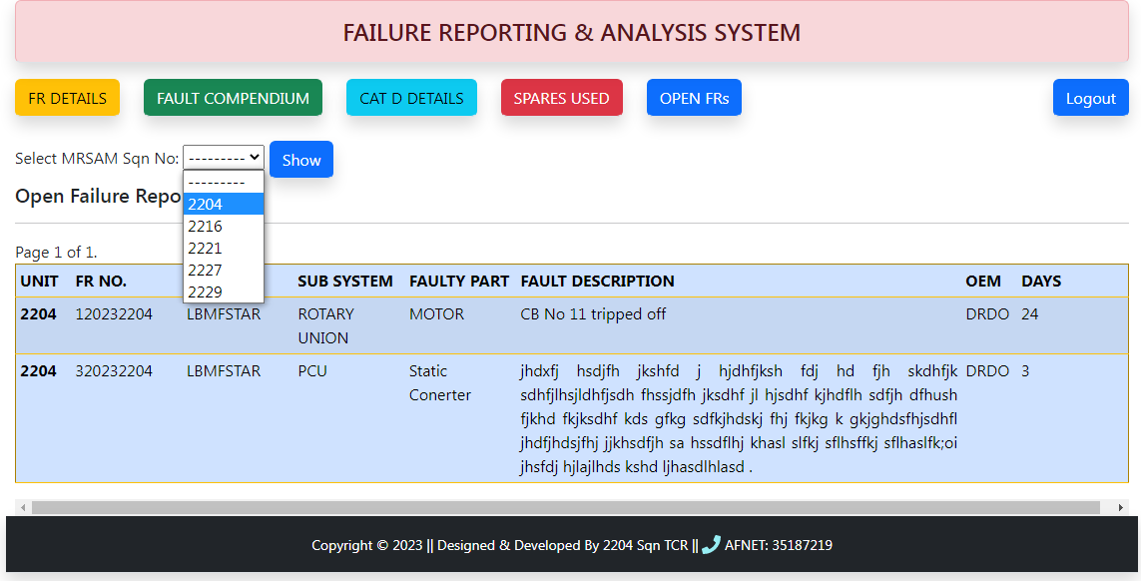
THE DASHBOARD
“Open” FRs with Days lapsed for selected MRSAM FUs

Slide 14
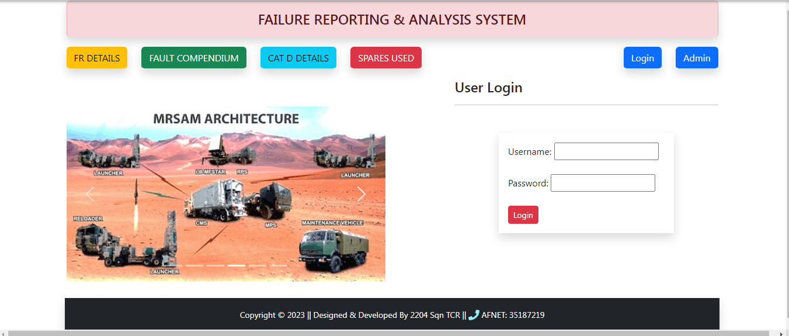
How FRAS works
This is the main page where user enters their credentials

Slide 15
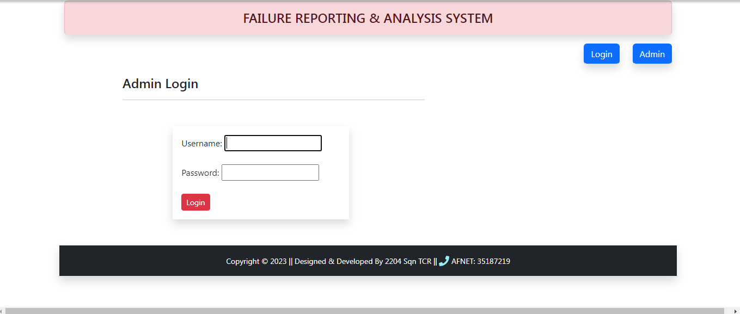
HOW FRAS WORKS
This is Admin Users Login Page

Slide 16
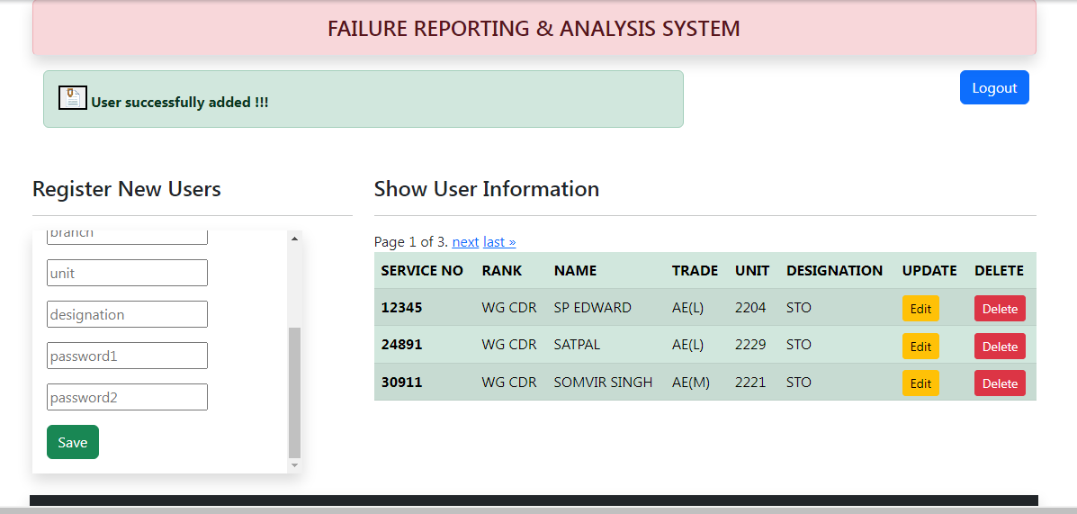
HOW FRAS WORKS
Admin User Screen
The Admin User will manage the Users. He can add, update, delete and reset the password of an user.

Slide 17
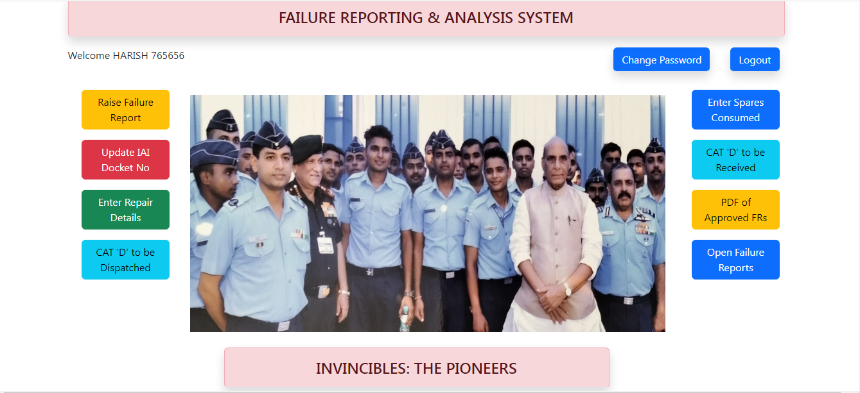
HOW FRAS WORKS
This is the Home Page where General User Lands after providing Username and Password. He can perform eight various types of activities.

Slide 18
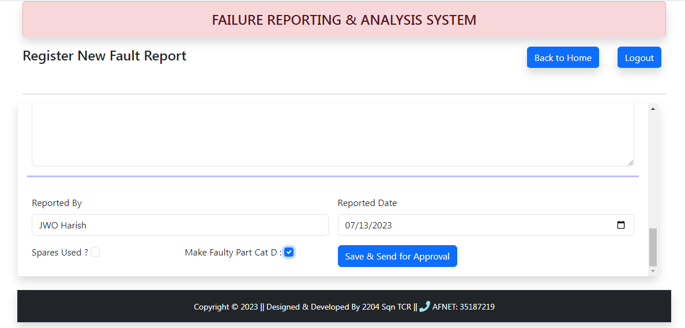
HOW FRAS WORKS
General Users Screen for Raising New FR
The user fills up the Form for registering new FR.
Saves it and send it for approval

Slide 19
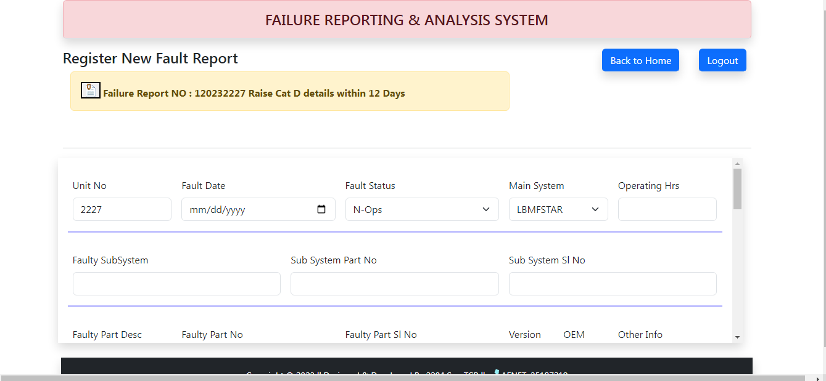
HOW FRAS WORKS
Unique FR No will be issued to each FR automatically
Cat D details if any has to be raised within 12 days.

Slide 20
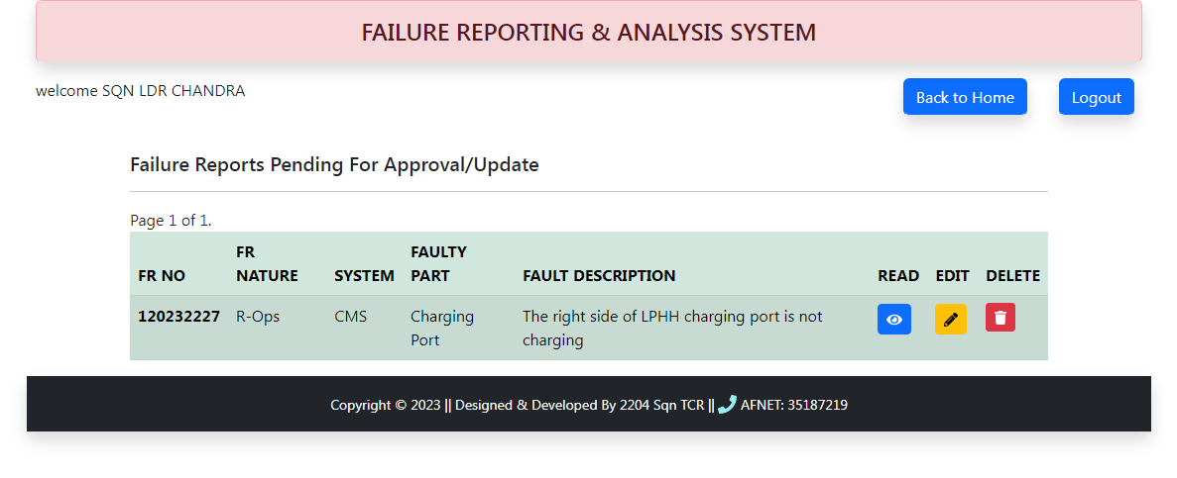
HOW FRAS WORKS
Approval Users Screen for Approving the FR
The newly raised FR will be shown to Approval User after he logs in.
The Approval User will have the pending FR for Approval.
He / She can Read, Update, Approve or Delete the FR

Slide 21
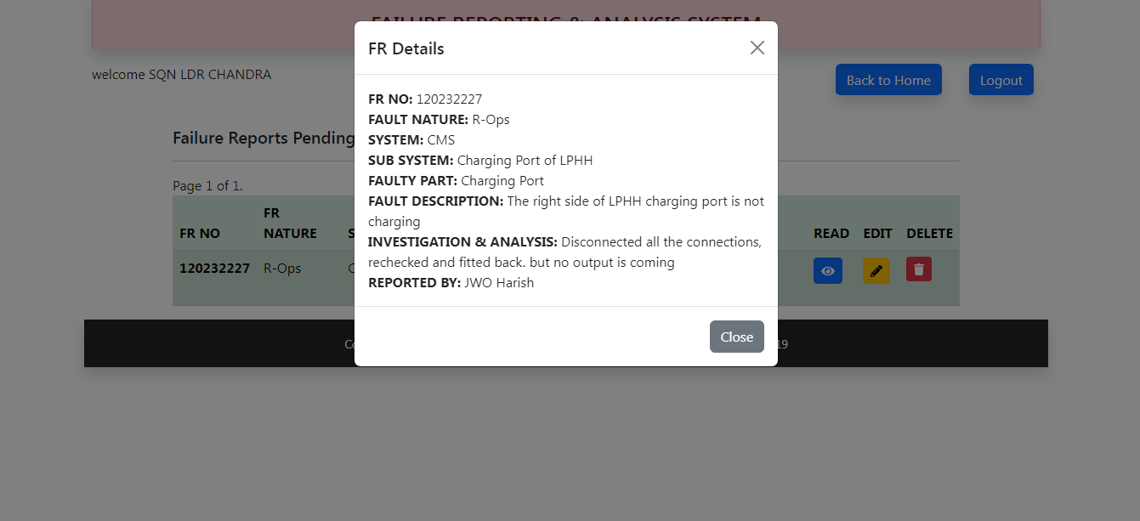
HOW FRAS WORKS
Approval Users Screen
The Reading window will appear on the click of Read button.
The entire FR information can be seen at once.

Slide 22
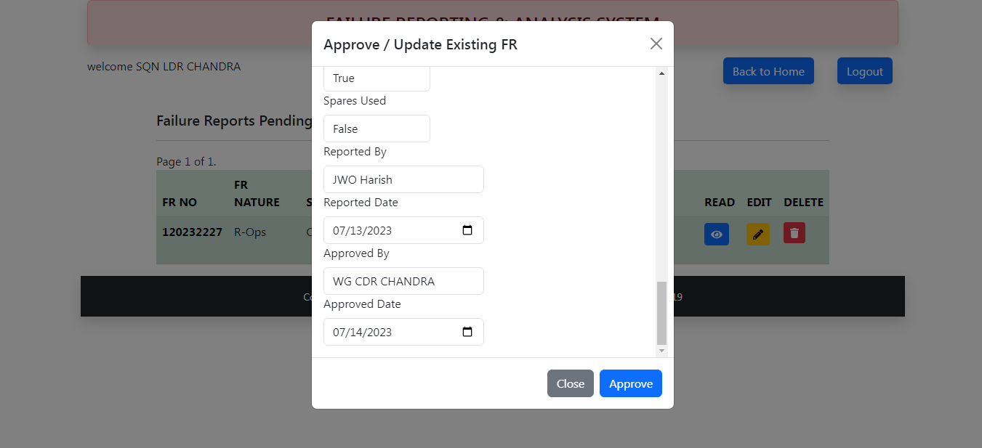
HOW FRAS WORKS
Approval Users Screen
When Edit button is clicked, the Approving / Updating window appears

Slide 23
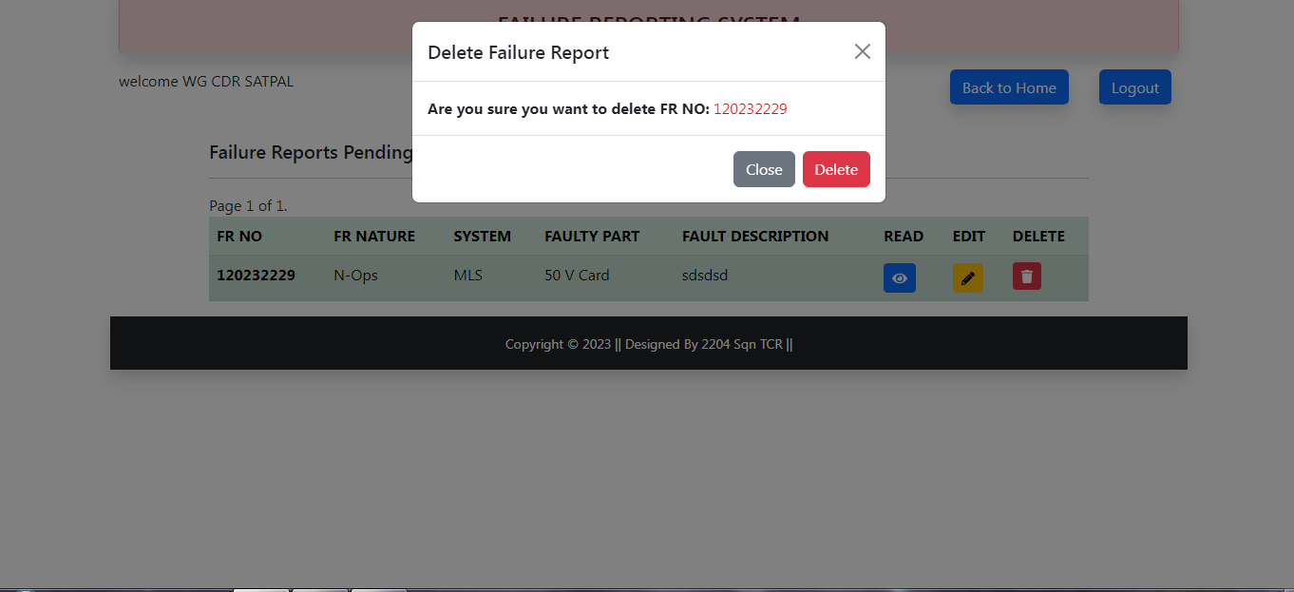
HOW FRAS WORKS
Approval Users Screen
When the Delete button is clicked, the user will be prompted for
Deletion of FR.

Slide 24
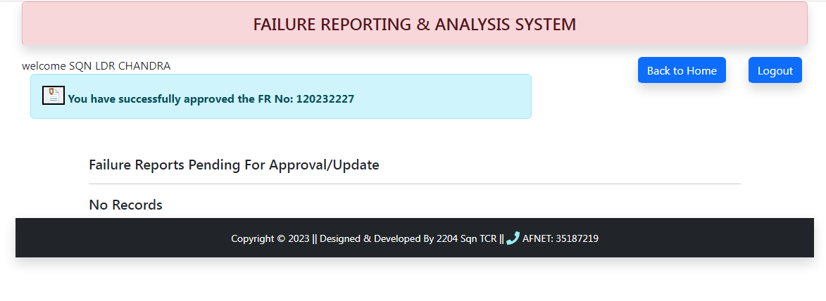
HOW FRAS WORKS
Approval Users Screen
Message will be shown to Approval User after the FR is Approved

Slide 25
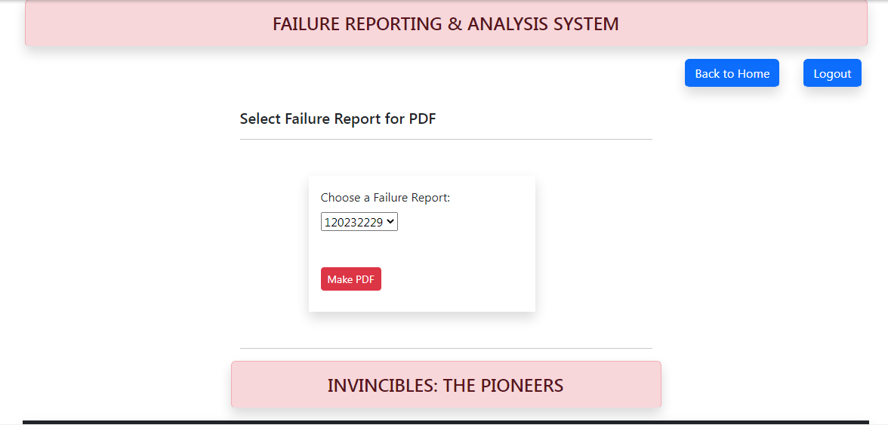
HOW FRAS WORKS
General Users Screen for Printing Approved FR
The General User logs in and select the “PDF of Approved FRs” on Home Page. The above screen will appear where it shows the Approved FR ready for print out. Approved FR can be selected from this Page for generating Report

Slide 26
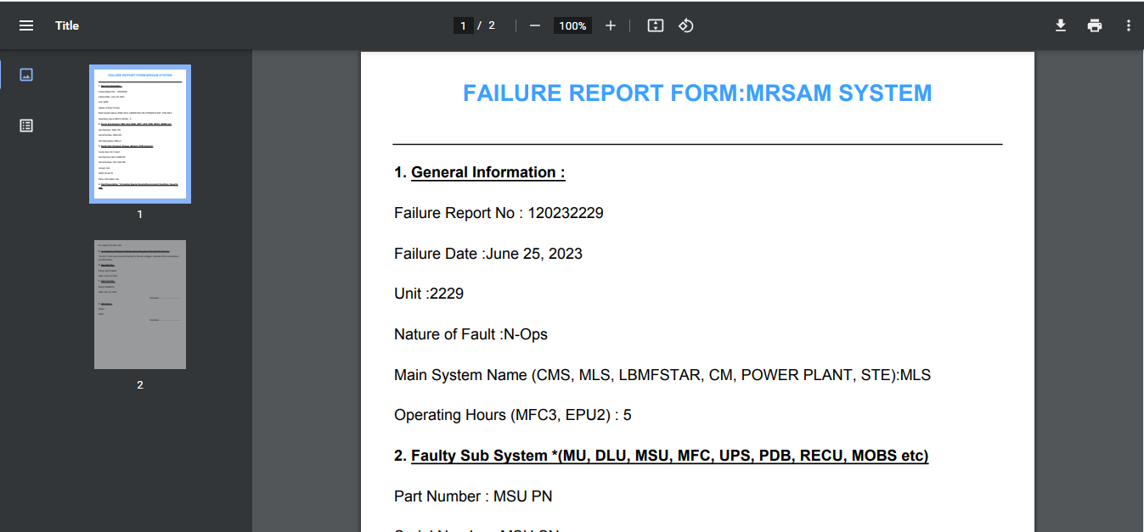
HOW FRAS WORKS
General Users Screen
Failure Report in PDF Format

Slide 27
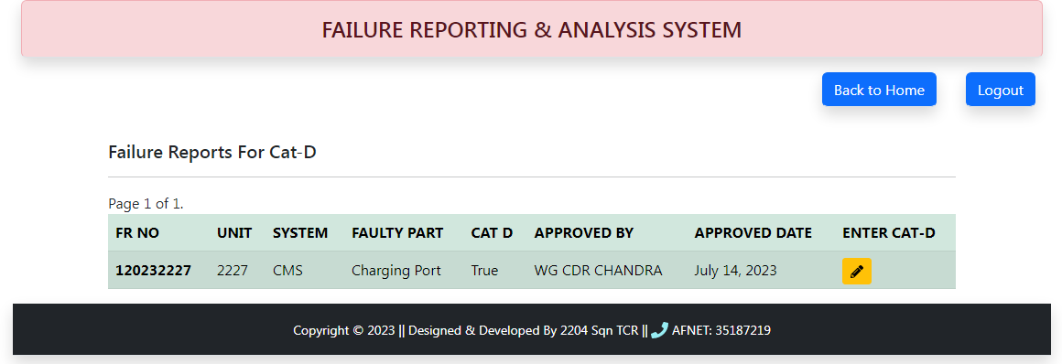
HOW FRAS WORKS
General Users Screen for Dispatching Cat D Items
The General User will carry out all tasks from his Home Page.
The User selects the “Cat Ds to be Dispatched” button on Home Page.
The above screen appears where user select the specific FR and enters
the details of Cat D shown in the next slide
Note-These raised FRs will remain for 12 Days to give time to user for
raising Cat D

Slide 28
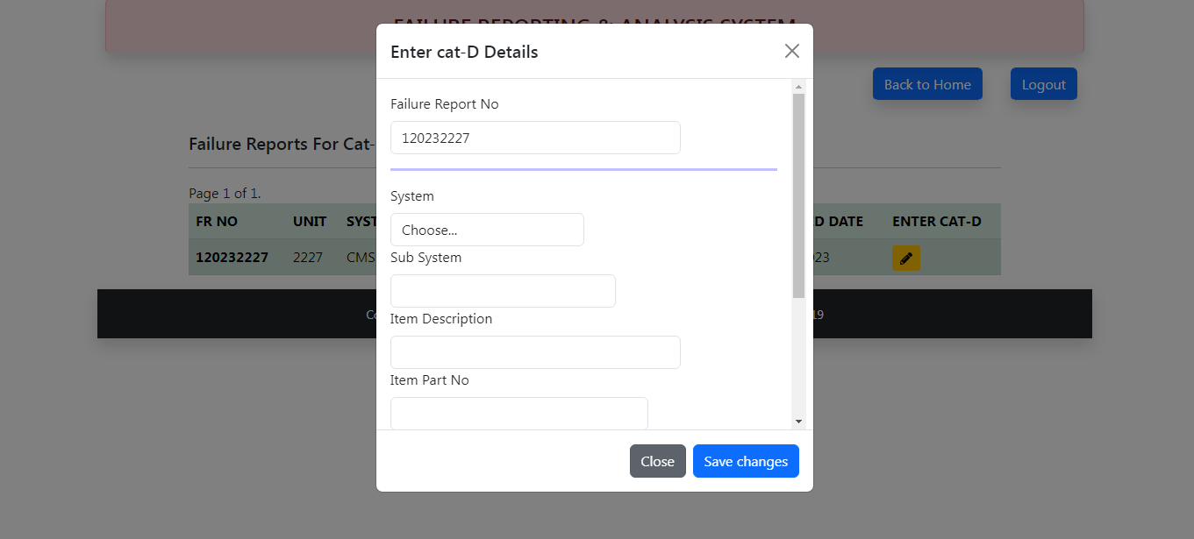
HOW FRAS WORKS
User enters the Cat D details and saves it against the selected FR

Slide 29
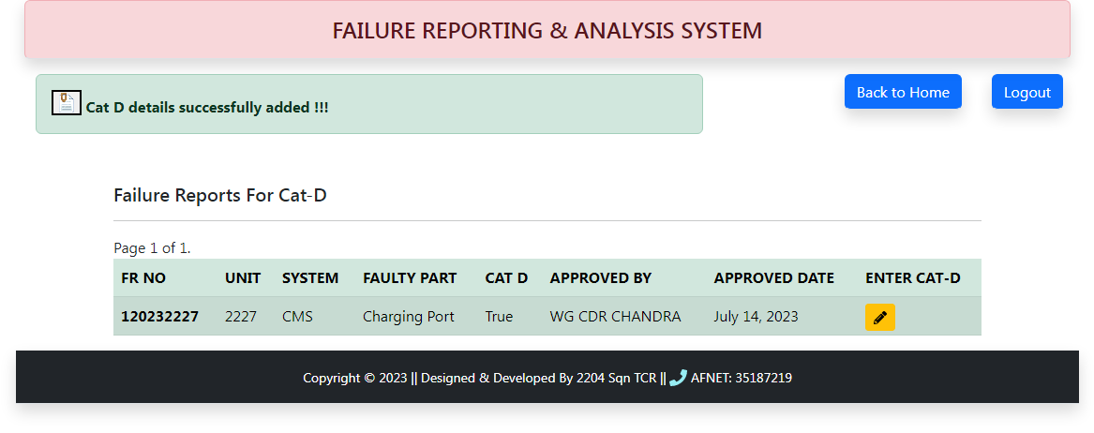
HOW FRAS WORKS
This FR list will be shown for 12 days and after that disappears.
It insists the users to dispatch the Cat D within 12 days.

Slide 30
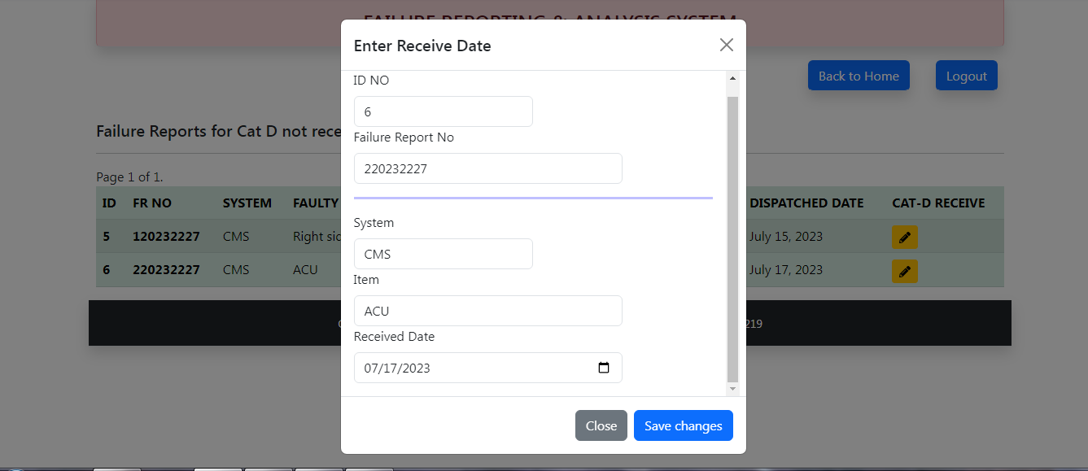
HOW FRAS WORKS
General Users Screen for Receiving Cat D Items
When the Cat D is received after repair, the user enter only the
received date.

Slide 31
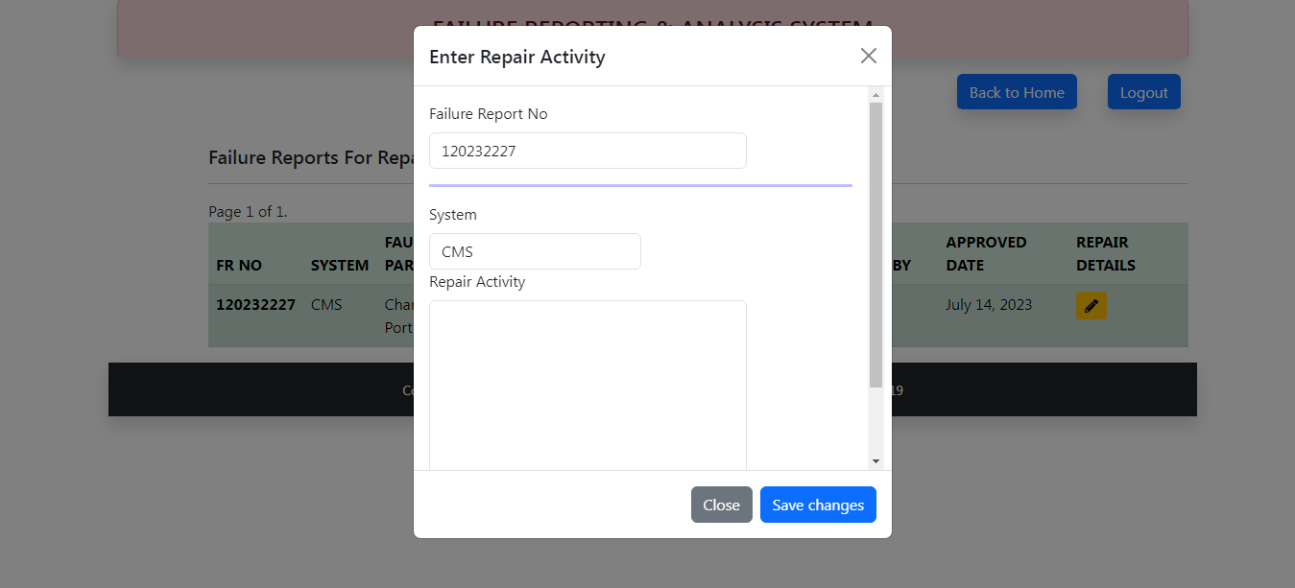
HOW FRAS WORKS
General Users Screen for Closing the FR
When a fault gets cleared , the user enters the rectification detail and FR gets closed automatically

Slide 32
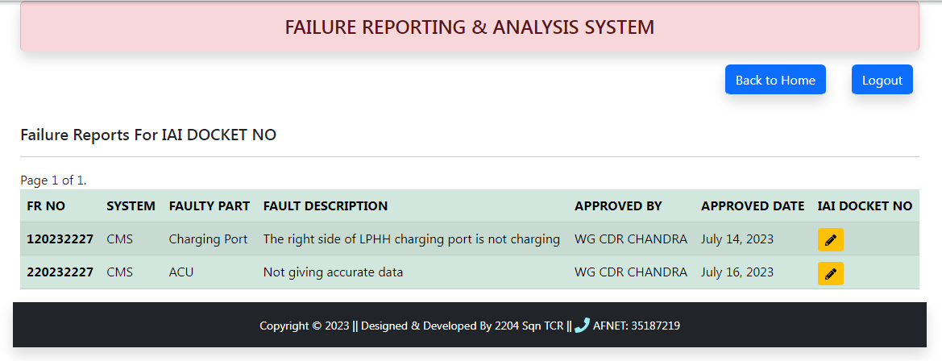
HOW FRAS WORKS
General Users Screen for Updating IAI Docket No.
When the user clicks the “Update IAI Docket No” the above screen appears for those FR whose IAI Docket No is not updated

Slide 33
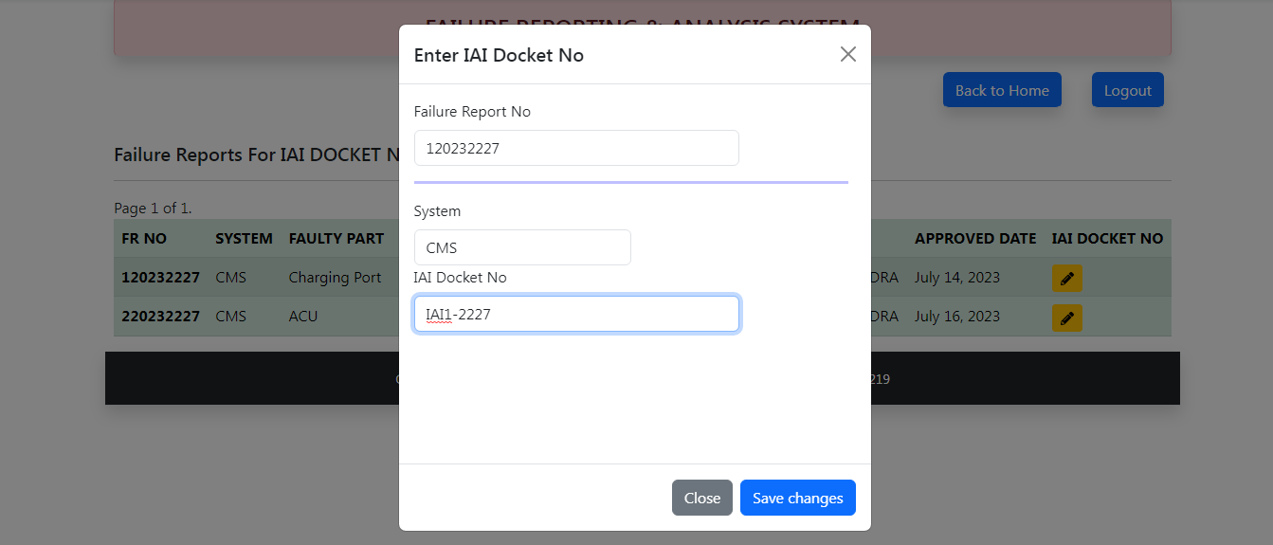
HOW FRAS WORKS
When the user selects a specific FR, a window appears to allow the user to enter IAI Docket No

Slide 34
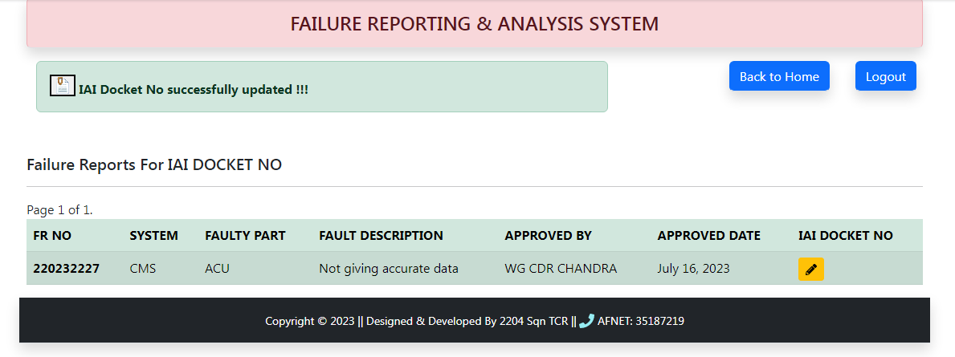
HOW FRAS WORKS
After saving the record User gets a message and the specific FR
Disappears.

Slide 35
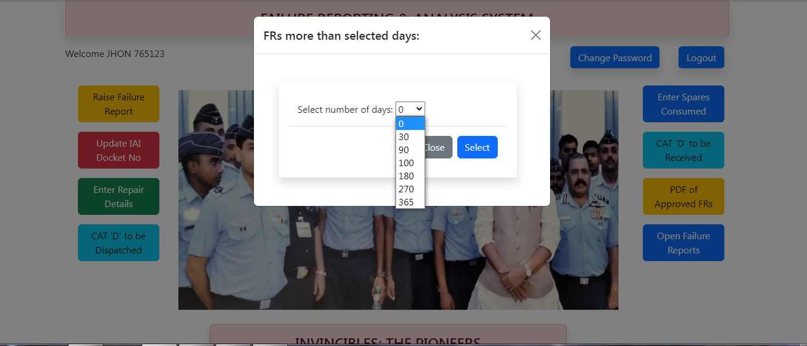
HOW FRAS WORKS
General Users Screen for Listing Open FRs.
When the user clicks the “Open Failure Reports” the above screen appears with an option to user to choose number of days lapsed

Slide 36
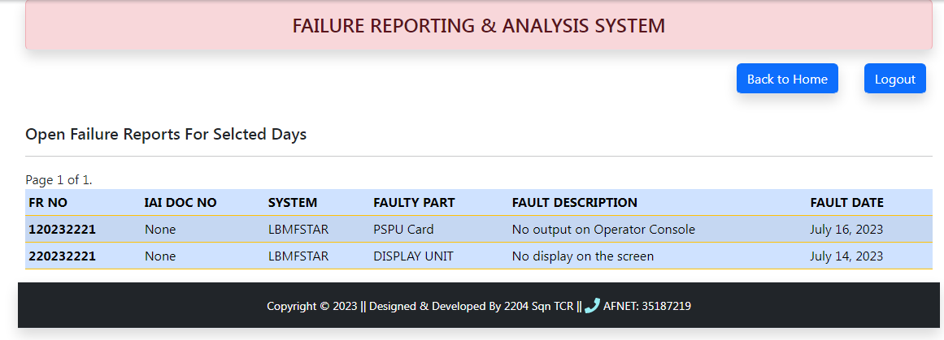
HOW FRAS WORKS
The User is able to monitor the Open FRs of his FU.

Slide 37
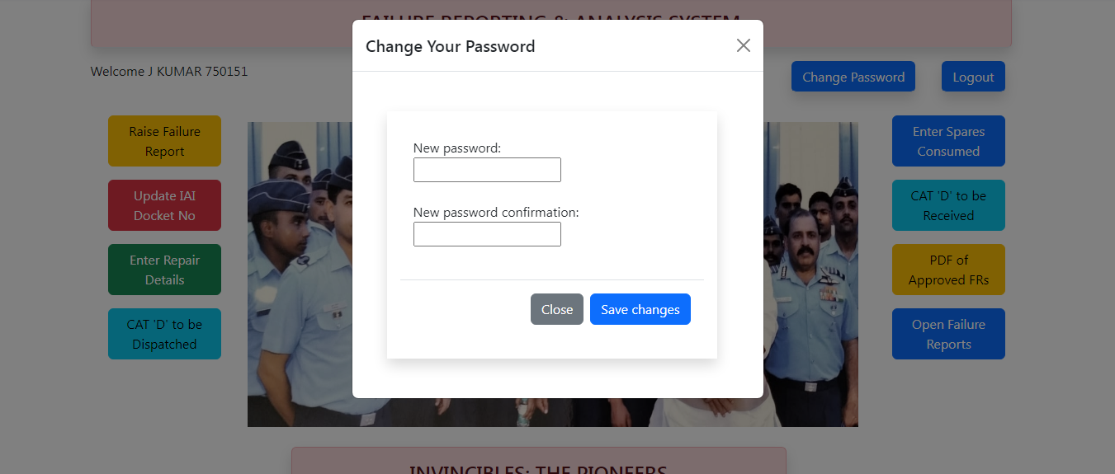
HOW FRAS WORKS
General Users Screen for Changing Password.
When the user clicks the “Change Password” the above screen appears.

Slide 38
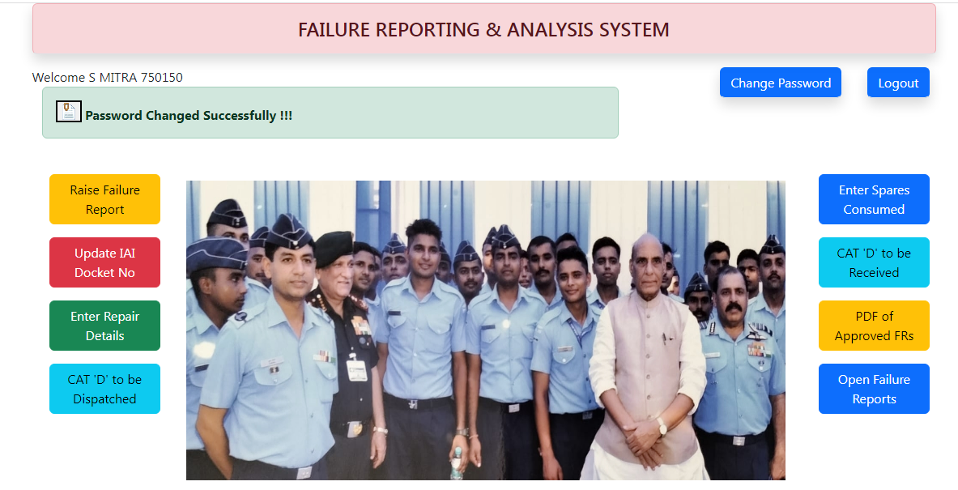
HOW FRAS WORKS
The message appears on the screen for successful Password Change

Slide 39
Jai Hind

